Slide 1
Pinhole penguin
A bright lamp that is the shape of a penguin is turned on.
It is put in front of a tiny cross-shaped hole.
?
Penguin lamp
Tiny cross-shaped hole

Slide 2
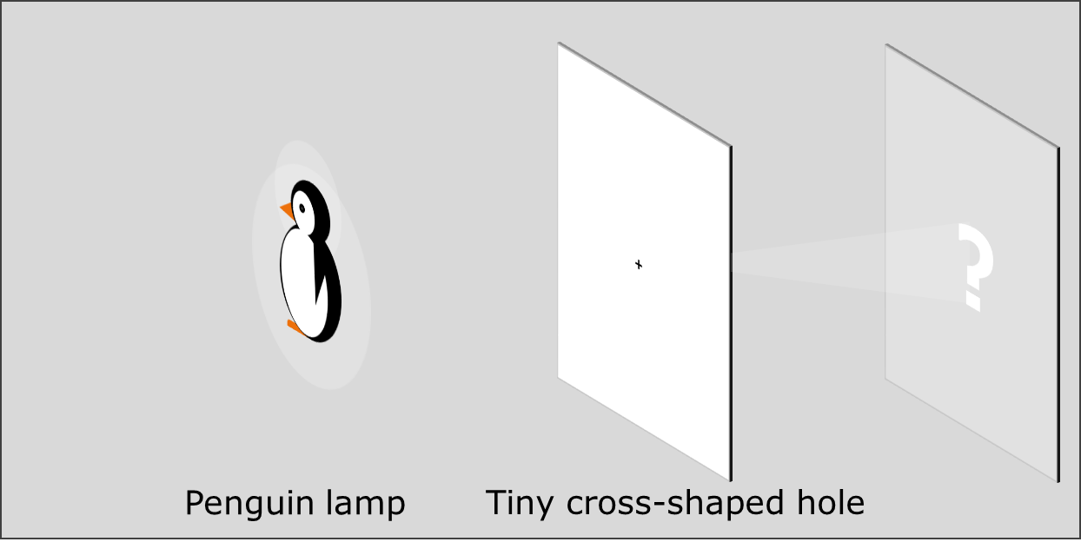
Pinhole penguin
a. What would you expect to see on the screen?
A
B
C
D

Slide 3
Pinhole penguin
Rays of light show which way light moves from the penguin lamp.
b. What can you say about rays to explain what you see on the screen?
I am sure this is right
I think this is right
I think this is wrong
I am sure this is wrong
A
Rays from the corners of the penguin are blocked
B
One ray from each point of the penguin goes through the cross
C
Many rays from each point of the penguin go through the cross
D
Light moving along each ray lights up a point on the screen
E
Light moving along rays from one point of the penguin go through the hole at a particular angle

